Slide 1
Instructions for Presentation on Lab Procedures
Please use this slide deck from a TES training in Angola as a template for presenting on study laboratory procedures to your in-country TES team.
There are additional instructions in the notes for each slide.

Slide 2
Procedures Laboratory

Slide 3
DAILY ACTIVITIES
AL
 | 0 | 1 | 2 | 3 | 7 | 14 | 21 | 28 |  |  | Ex
 | 0 | 1 | 2 | 3 | 7 | 14 | 21 | 28 |  |  | Ex
 | 0 | 1 | 2 | 3 | 7 | 14 | 21 | 28 | 35 | 42 | Ex
Parasitemia |  | Only serious malaria
Filter paper
Haemoglobin
ASAQ
DP
Ex: excluded
Clinical signs of severe malaria:
Changes in consciousness
Prostration
Multiple convulsions
Lab signs of severe malaria:
hyperparasitaemia (>4%)
renal insufficiency (elevated serum creatinine)
severe anaemia (haemoglobin < 5 g/dl)
Note: daily evaluation of the results will be done by the clinical staff involved in the study.

Slide 4

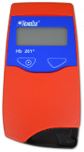
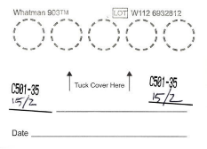
Three Responsibilities
1. microscopy
2. Haemoglobin measurement
3. Dried blood sample

Slide 5
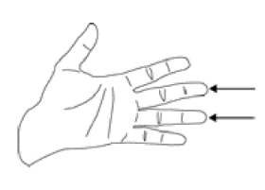
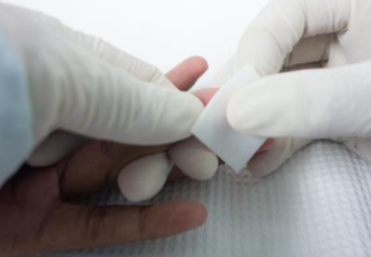
Finger prick
Putting on gloves
Disinfect of the patient's finger with alcohol
Leave to dry

Slide 6
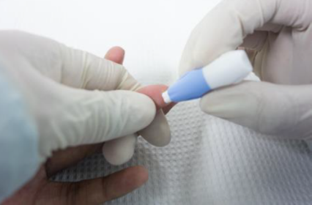
Finger Prick
4. Hold the finger firmly
5. Press the lancet on the finger

Slide 7
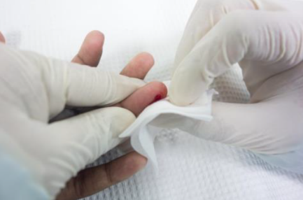
Finger Prick
6. Press lightly on the finger to get 1 drop
7. Wipe the 1st drop from the finger

Slide 8
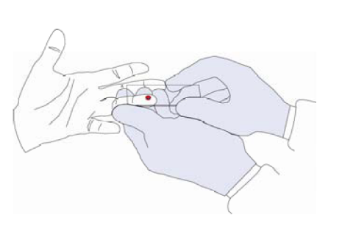
Finger Prick
8. Prepare the microscope slide

Slide 9
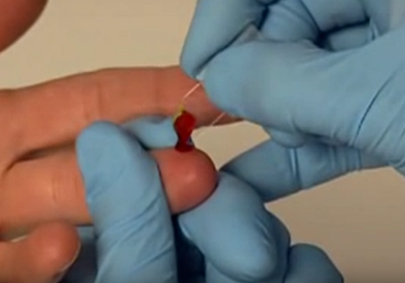
Finger Prick
9. Prepare the microcuvette

Slide 10
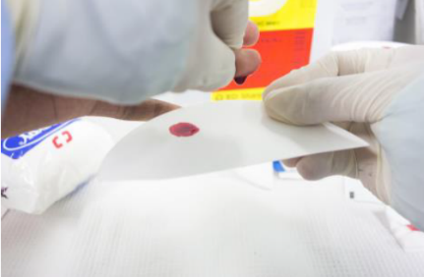
Finger Prick
10. Prepare the filter paper

Slide 11
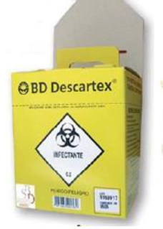

Finger Prick
Put lancets in the sharps box and other material in the infectious waste

Slide 12
1: Microscopy

Slide 13
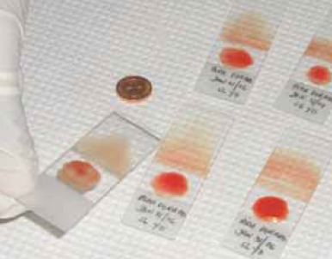
Slide Preparation
(thick drop and smear)

Slide 14
Labelling - Documentation
Each slide should receive a label, corresponding to the patient ID number
ZZ19-201-D1

Slide 15
Slide Identification
Card No., (Number that corresponds to the patient’s study ID card)
Province and local code
The respective day (D0)
The date on which the sample was taken

Slide 16
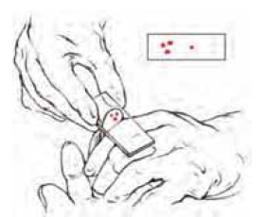
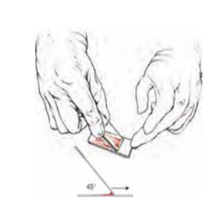
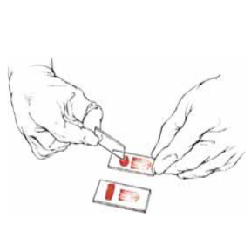
Slide Preparation

Slide 17
Preparation of Giemsa stain 10% or 3%
Giemsa stain should be prepared (diluted) every day
rest 30-60 mins before use
Dilute 10 cc or 3 cc of concentrated giemsa in a beaker
Add 90 or 97 cc of buffered water with pH = 7,2

Slide 18
Preparing the slide
Dip the slide quickly in methyl alcohol and leave to dry
Place Giemsa stain on the slides
Leave the preparations in contact with the dye for 15-30 min

Slide 19
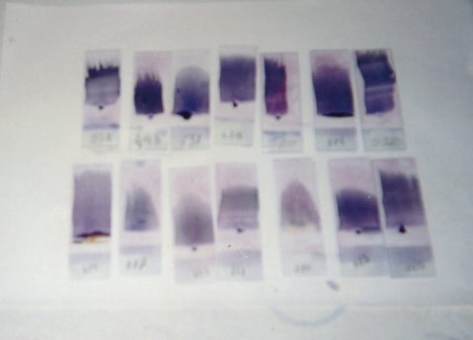
Stained Slides

Slide 20
Reading
Microscope with immersion lens using immersion oil.
Look for:
Ringed forms (trophozoites)
gametocytes with red nucleus or chromatin
blue cytoplasm
Notes:
*Fay will add

Slide 21
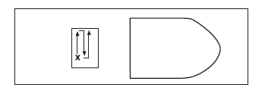
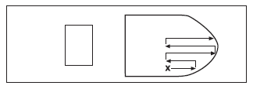
Parasite count
The parasite count should be done from one end of the drop to the other.

Slide 22
Parasite count
Parasites appearing in 200 white blood cells should be counted simultaneously.
For counting, it is recommended to use 2 cell counters
One for the parasites
Other for white blood cells (leukocytes)

Slide 23
FORMULA
If you have counted 500 parasites before 200 white blood cells are counted you can stop counting after the last field is completed and do the math, using the following formula:
No. of parasites counted x 8000 leuc
No. of leuc counted
=
Parasites
by
microlitre

Slide 24
2 Readings
The slides should be recounted again at the end of the day
Confirmation of previous count
Internal quality control

Slide 25
Discordance - 3rd Reading
____________________ – ____________________ = _________________
(higher parasitemia) (lower parasitemia) Difference
____________________ / ____________________ * 100 = ___________
Difference (lower parasitemia) %
Take 3rd reading if % is greater or equal to 25%.

Slide 26
Discordance - 3rd Reading
1st Reading: 30,000
2nd Reading: 40,000
40,000 – 30,000 = 10,000
(higher parasitemia) (lower parasitemia) Difference
10,000 / 30,000 * 100 = 33.3
Difference (lower parasitemia) %
33.3% is greater than 25%
The 3rd reading is done

Slide 27
Discordance - 3rd Reading
1st Reading: 65,000
2nd Reading: 75,000

Slide 28
Discordance - 3rd Reading
1st Reading: 65,000
2nd Reading: 75,000
75,000 – 65,000 = 10,000
(higher parasitemia) (lower parasitemia) Difference
10,000 / 65,000 * 100 = 15.4
Difference (lower parasitemia) %
15.4% is NOT greater than 25%
NO 3rd reading

Slide 29
Conservation of slides
The slide when drying should be:
out of reach of insects and dust
duly identified with number, code, date and day of collection
The number on the slide should be the same as the number on the study sheet
At the end of the reading, the slides should be carefully stored in appropriate boxes
ATTN!!! Do not wash the blades with xylol

Slide 30
Continued
After the slides have been read, they should be carefully placed, face down, on clean and suitable absorbent paper, to absorb the oil.
All the slides of the patients included in the study must be kept.
In the absence of appropriate boxes, these may be wrapped in absorbent paper, duly labelled and identified.

Slide 31
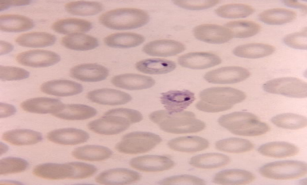
Plasmodium sp

Slide 32
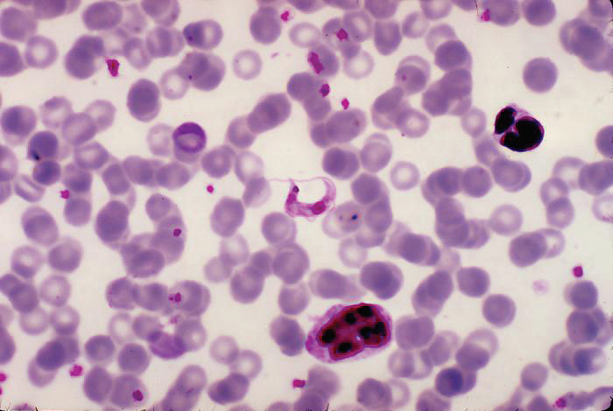
Blood Smears

Slide 33
Blood Smears

Slide 34
Leukocytes

Slide 35
Plasmodium vivax

Slide 36
Plasmodium falciparum

Slide 37
Plasmodium ovale

Slide 38
PLASMODIUM MALARIAE

Slide 39

2: Haemoglobin

Slide 40
HAEMOGLOBIN TEST OR HAEMATOCRIT
Haemoglobin is measured using a haemoglobinometer or a micro-hematocrit.

Slide 41
Haemoglobin
Haemoglobin is measured in all study participants
Every 14 days
D0, D14, D28 and D42
Also on unscheduled visits

Slide 42
Haemoglobin I
Take a blood sample
Remove the cuvette from the cuvette container and cap the container immediately. Place the tip of the cuvette into the center of the drop of blood and allow the blood to collect in the cuvette
Fill the vial completely in a continuous process. It should never be completely full after the first filling (i.e. filled halfway, removed from near the drop of blood and then filled again)
If the cuvette is not completely filled with a drop of blood, take a new cuvette and fill it properly in a continuous process. NEVER use a half full cuvette for the sample

Slide 43
Haemoglobin II
If air bubbles are present in the cuvette after filling with blood, use a new cuvette and obtain a new blood sample
Remove excess blood on the outside of the cuvette tip using a clean paper towel
In this process, make sure that there is no blood outside the cuvette

Slide 44
Hemoglobin III - the Hemocue machine
Open the cuvette holder
Press the left button (the button with the circle) and the machine will switch on
An hourglass will appear in the lower left corner of the machine. This means that the machine is self-calibrating

Slide 45
Hemoglobin IV- the Hemocue machine
When you see three flashing dashes and the HemoCue symbol, the machine is ready to take a measurement
Place the filled vial in the sample chamber of the HemoCue Photometer. The filled cuvette MUST be placed in the photometer within 10 minutes of sampling. Measurements taken after 10 minutes may result in erroneous haemoglobin counts
Insert the holder in the measuring position
During measurement, an hourglass will appear on the screen

Slide 46
Haemoglobin V - the Hemocue machine
The results will appear within 15 to 60 seconds
Record the haemoglobin results
Remove the cuvette holder from the photometer, remove the cuvette that was read and dispose of it in the biological waste container
To turn the machine off, press and hold the left button until the display screen turns off

Slide 47
Haemoglobin - Notes
NOTE: After 15 minutes of non-use the machine will switch off.
NOTE: Never press the power button for purposes other than turning the machine on or off. Pressing this button will show previous measurements and it will be difficult to tell which measurement is current and correct.

Slide 48
Haemoglobin - Notes
Daily quality control
The machine has its own quality control process. No control cuvettes are required. HemoCue machines should be cleaned every Friday with HemoCue cleaner in the health facility or whenever the study supervisor suspects that blood has been spilled inside the HemoCue machine

Slide 49
Part 3: Filter Paper

Slide 50
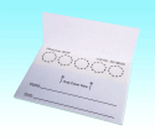
Filter Paper I
Materials required
Protein saver blood collection card (Whatman 903 filter paper)
Ziploc bags
Desiccant pack
Scissors
Alcohol swab

Slide 51
Filter Paper II
Open the protein saver blood collection card (Whatman 903 filter paper)
Label both ends of the card
Write the date on both labels
Collect blood onto filter paper ONLY after
performing the haemoglobin test and
preparing the blood smear

Slide 52
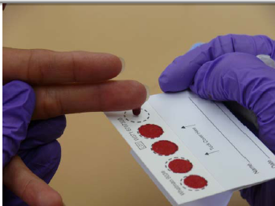
Filter Paper III
The card contains 5 half-inch (1.27cm) circles that hold 50-100 μl each of the sample and a space for the name and date of the collection.

Slide 53
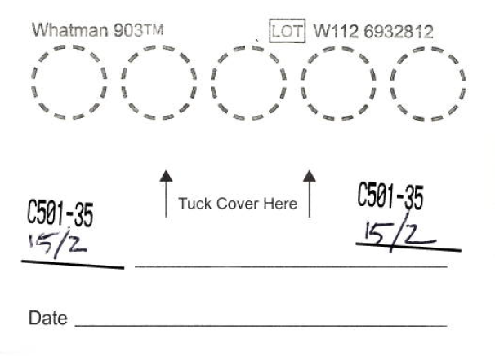
Filter Paper IV
Label
Label

Slide 54
Filter Paper V
Allow a drop of blood to form in the center of each spot shown or gently touch the drop of blood with the Whatman 903 blood collection card. Allow the drop of blood to evenly saturate the entire circle. (NB: do not add more than one drop per circle, do not touch the 903 Protein Holding Card at any time during collection; do not press the puncture site with the filter paper)
Fill in as many circles as possible on the card. Start at the edges and continue towards the middle.
After blood collection, ask the patient to press a small dry cotton ball on the puncture site for a few minutes to stop the bleeding.

Slide 55
Filter Paper VI
Start at the extremities of the card so that both sides have at least one drop of blood

Slide 56
Filter Paper VII
Start at the extremities of the card so that both sides have at least one drop of blood

Slide 57
Filter Paper VIII
Start at the extremities of the card so that both sides have at least one drop of blood

Slide 58
Filter Paper IX
Start at the extremities of the card so that both sides have at least one drop of blood

Slide 59
Filter paper X
Start at the extremities of the card so that both sides have at least one drop of blood

Slide 60
Filter paper XI
Let the 903 card dry:
Away from direct sunlight
in a clean place
well ventilated and dry area
protected against rodents and insects
Place the 903 card on a bench
for at least 4 hours until the drops of blood have completely dried
but not > 24 hours at room temperature

Slide 61
Filter Paper XII
When dry
cut the card in half with clean scissors (sterilize using an alcohol swab)
make sure that both cut halves of the 903 card contain the child's identification number and date.

Slide 62
Filter Paper XIII
Close the cover of the two halves of the 903 card
place each one in an individual Ziploc bag
place a desiccant packet inside each bag and seal

Slide 63
Filter Paper XIII
The sealed and dry 903 protein saver card can be stored at room temperature (if the room temperature does not exceed 30 °C) for up to 3 weeks.
Afterwards, the closed and dried 903 cards can be stored at 4 °C for a period not exceeding 4 months.
For long-term storage, cards should be stored in the freezer at -70 °C for the first 3 weeks after sample collection.

Slide 64
Examples of Poor Quality Samples
A. Insufficient quantity of blood
B. Too much blood
C. Samples that appear coagulated or clumped
D.Samples that appear diluted, discoloured or contaminated
E. Samples with alcohol circles
F. Samples not dried before storage

